Slide 1

Diverse Uses of a Semantic Graph Database for Knowledge Organization and Research
Vladimir Alexiev, PhD, PMP
Chief Data Architect, Ontotext Corp

Slide 2
Outline
Knowledge Graphs and Semantic Databases
Zotero Bibliography
Commercial Applications
Thesaurus and Ontology Management
Semantic Publishing
Life Sciences
Knowledge Graphs of Science
Financial Industry
Industrial Data: Electrical CIM, Industry 4.0
Research Applications
Lexicography,
Digital Humanities: Holocaust Research, Iconography, Thesauri
Geographic Data
Economics, Innovation, Business Data
News, semantic annotation and search, popularity ranking
More info: github
Diverse Uses of a Semantic Graph Database for Knowledge Organization and Research

Slide 3
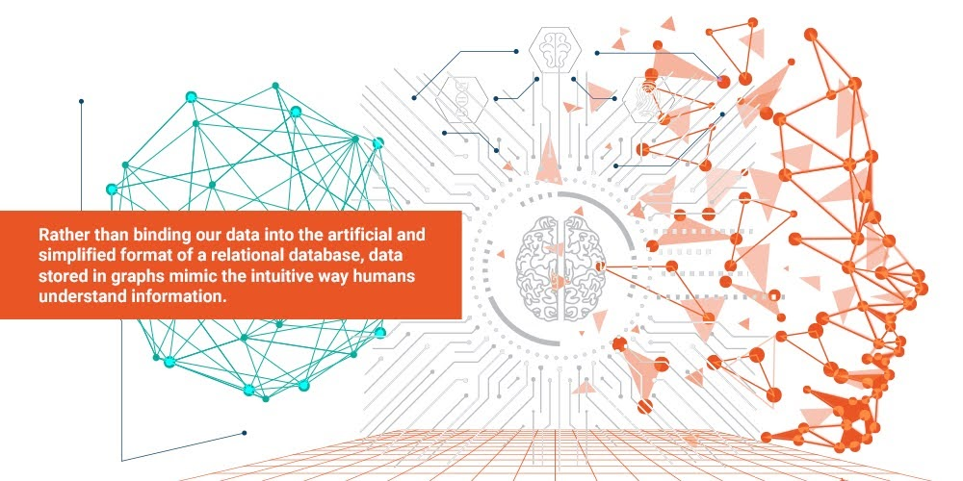
Knowledge Graphs and Semantic Databases
Semantic Graph Databases (SGDB)
The foundation of Enterprise Knowledge Graphs
W3C compliant RDF storage and serialization, RDFS and OWL reasoning, SPARQL 1.1 querying
RDF* and SPARQL*
User-friendly UI for administration
Lucene, SOLR, Elasticsearch, Mongo connectors
RDBMS virtualization
GeoSPARQL and SPARQL-MM plugins
History and Versioning
Java, JavaScript, GraphQL APIs
Built-in visualizations and charts
OpenRefine data cleaning
Visual RDF mapping
JDBC/ODBC interface for Tableau/PowerBI
Open source or free/community versions
Enterprise features (clustering, security)
Diverse Uses of a Semantic Graph Database for Knowledge Organization and Research

Slide 4
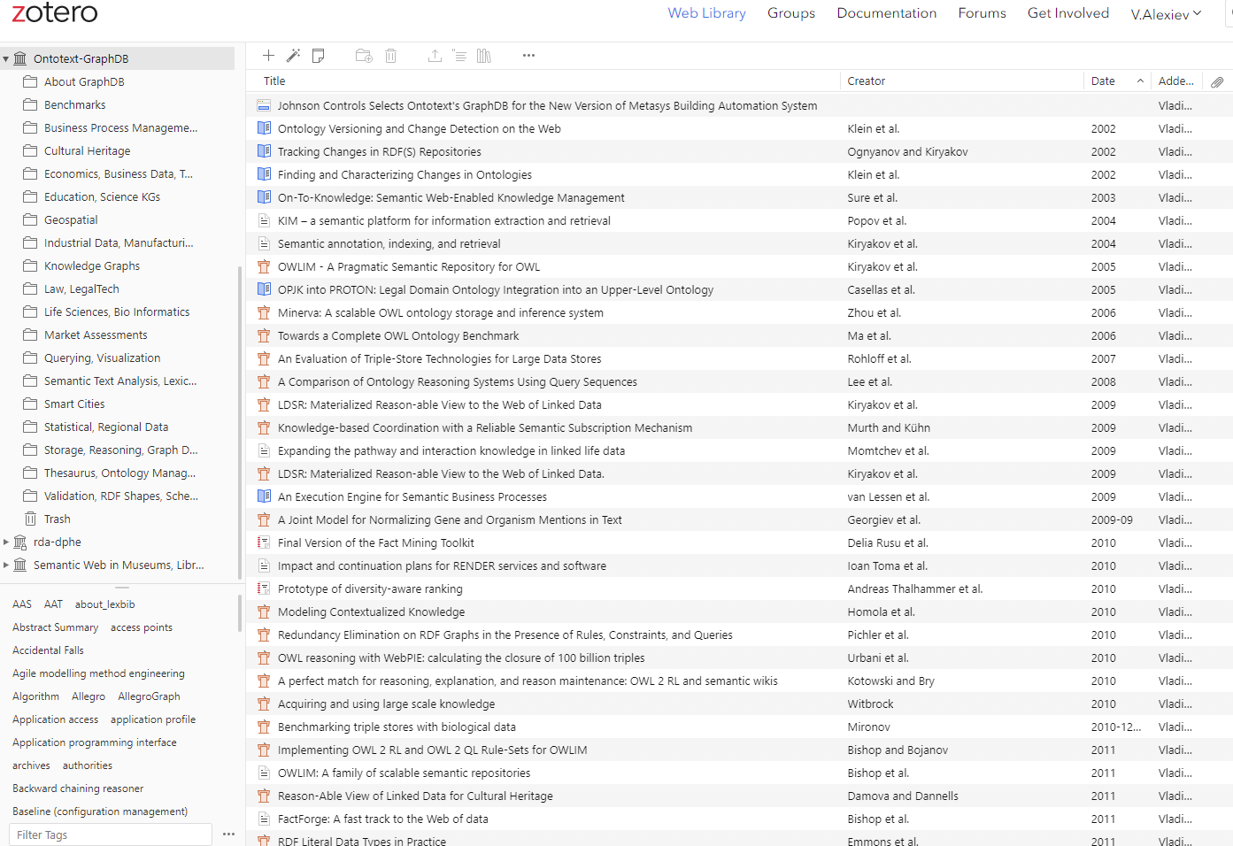
Zotero Bibliography (more info on github)
Diverse Uses of a Semantic Graph Database for Knowledge Organization and Research

Slide 5
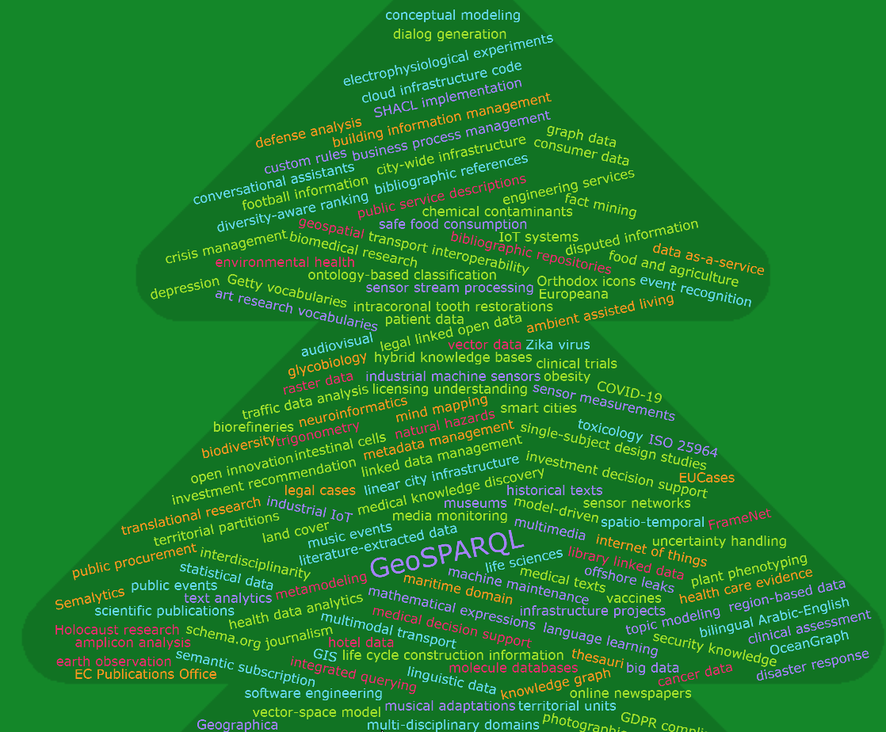
175 Papers on a Number of Topics
Benchmarks (13): various benchmarking efforts where SGDBs have been evaluated
Business Process Management (2): applications of semantic technology to BPM
Cultural Heritage (11): cultural heritage and digital humanities
Economics, Business Data, Tourism (11): tourism, hotels, investment decision support, company data, industry classification
Education, Science KGs (5): science data, academic management, etc
Geospatial (5): geospatial data and benchmarks
Industrial Data, Manufacturing (8): industrial standards, sensors, building automation
Knowledge Graphs (6): KG techniques
Law, LegalTech (2): legal texts and knowledge bases
Life Sciences, Bio Informatics (19): genes, organisms, biomedical ontologies, semantic search
Querying, Visualization (6): SPARQL optimization, query writing, NLP querying, visualization
Semantic Text Analysis, Lexicography, Semantic Publishing, Social Networks (18)
Smart Cities (3): city infrastructure, cyber-physical systems
Statistical, Regional Data (3)
Storage, Reasoning, Graph Databases (22): storage techniques, reasoning, rules
Thesaurus, Ontology Management, Conceptual Modeling, Classification (11)
Validation, RDF Shapes, Schemas (2): SHACL implementation benchmarks, APIs from shapes
Diverse Uses of a Semantic Graph Database for Knowledge Organization and Research

Slide 6
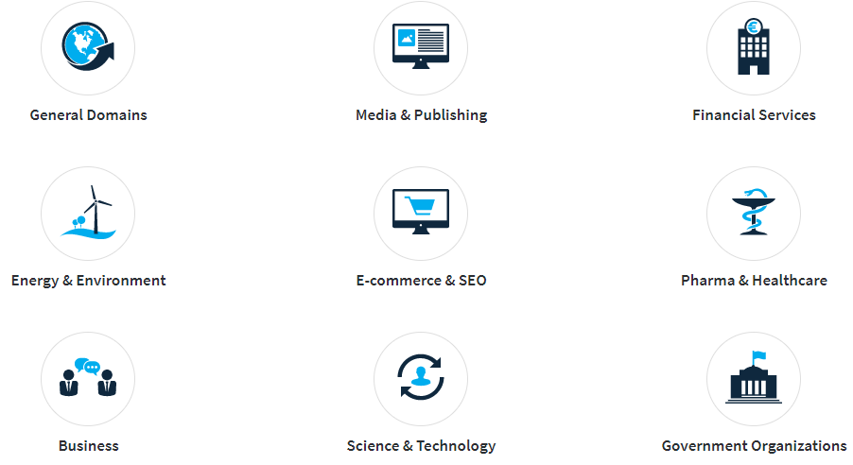

Thesaurus and Ontology Management
Major thesaurus and ontology management systems using SGDB:
VocBench 3: open source, collaborative editor for ontologies, thesauri, lexicons (SWJ 2019). Funded by UN FAO, EU OPOCE, EU ISA2
PoolParty Semantic Suite: Thesaurus Server, Search Server, Extractor, GraphEditor, Semantic Classifier, Semantic Integrator, UnifiedViews, PowerTagging, GraphSearch Server, CardSorting, GraphViews, API (ESWC 2010)
Synaptica Graphite: ontology and thesaurus manager
Metaphactory: semantic search, visualization (forms, OntoDia), thesaurus and ontology editor (SWJ 2019, blog 2021-02)
Important thesauri managed or published using SGDB:
AgroVoc
EuroVoc
Getty Vocabularies (AAT, TGN, ULAN)
Springer-Nature thesauri
Nomenclature for Museum Cataloging
More thesauri:
BARTOC
PoolParty Vocabulary Hub
Diverse Uses of a Semantic Graph Database for Knowledge Organization and Research

Slide 7
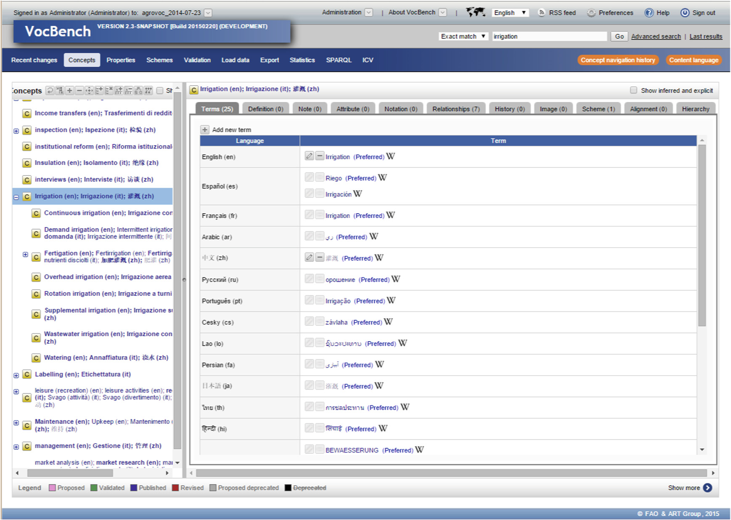
VocBench
Diverse Uses of a Semantic Graph Database for Knowledge Organization and Research

Slide 8
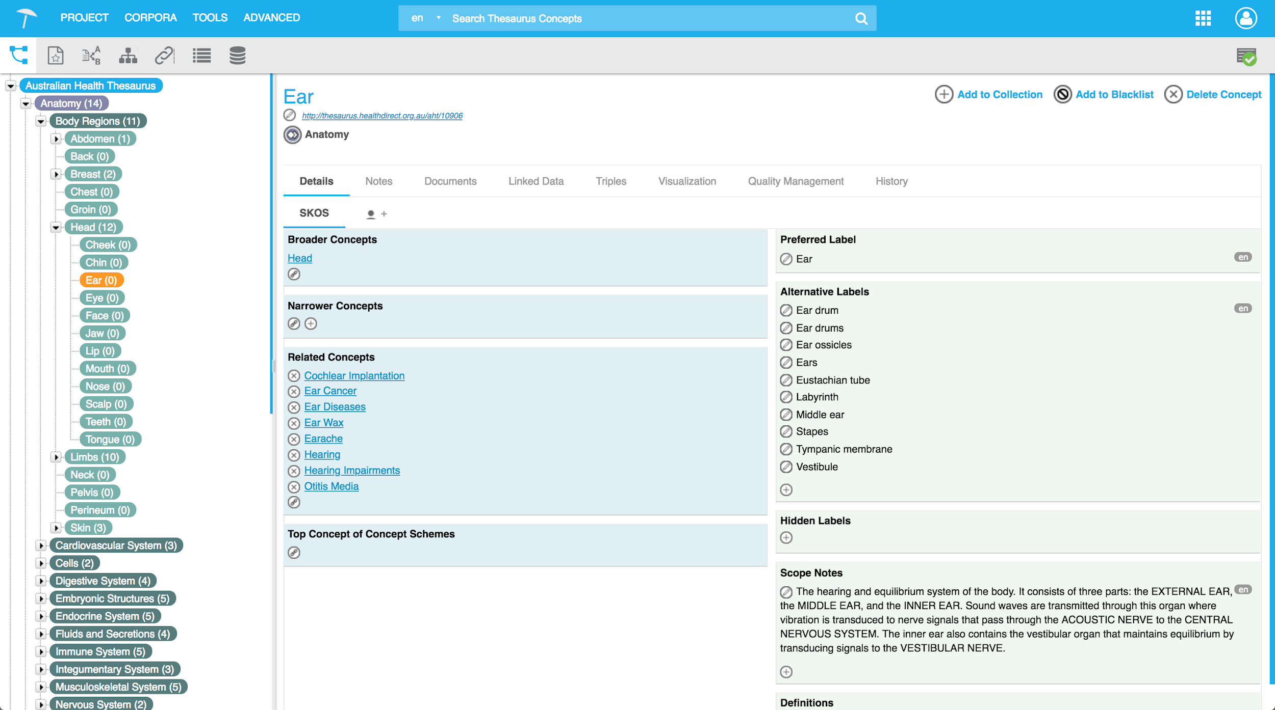
PoolParty
Diverse Uses of a Semantic Graph Database for Knowledge Organization and Research

Slide 9
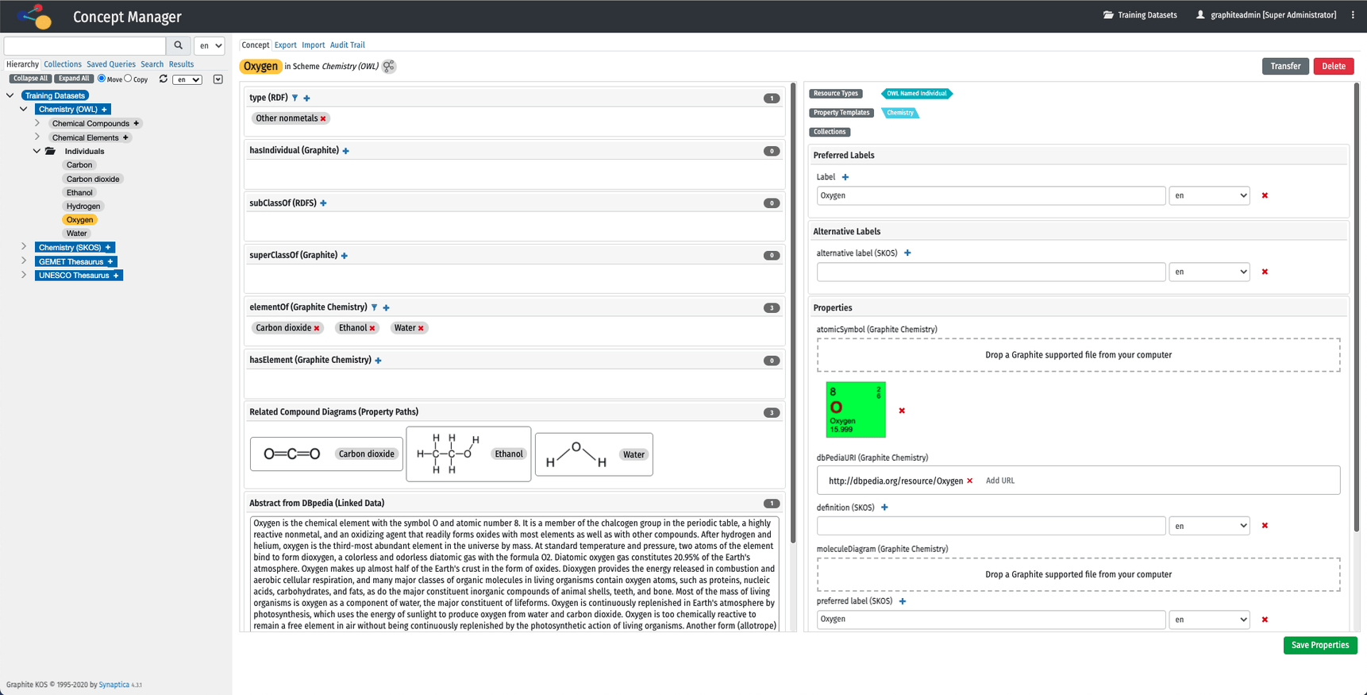
Synaptica Graphite
Diverse Uses of a Semantic Graph Database for Knowledge Organization and Research

Slide 10
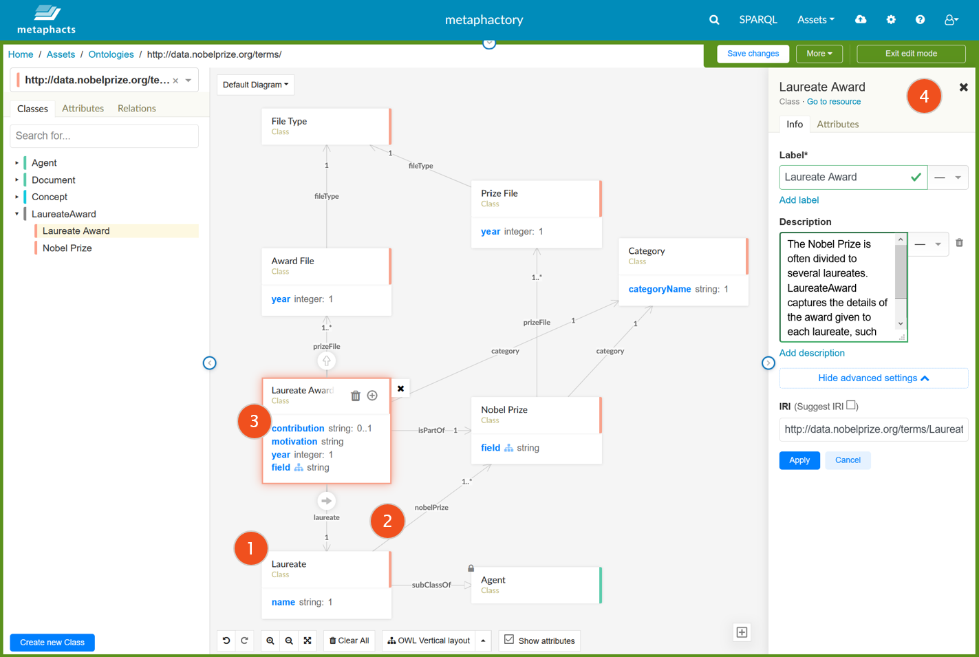
Metaphactory
Diverse Uses of a Semantic Graph Database for Knowledge Organization and Research

Slide 11
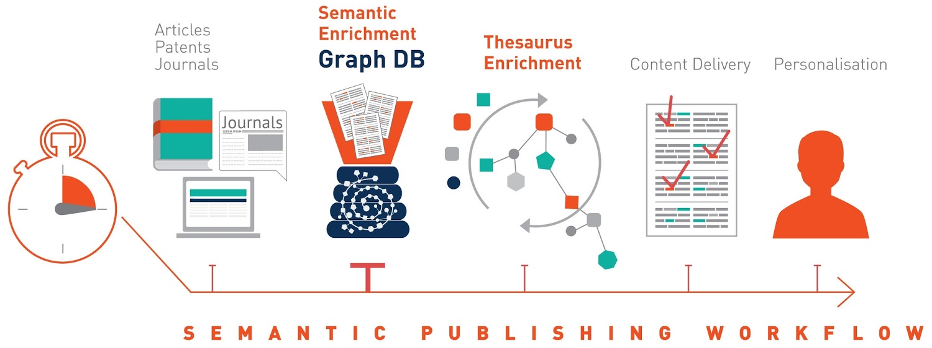
Semantic Publishing
Mass-media publishers
BBC, UK Press Association
Scientific, Technical, Engineering, Medical (STEM), Economic, Academic
IET, Elsevier, OUP, Wiley, Financial Times, Euromoney, S&P Global Platts
Government
EU Publications Office
UK Parliament
Diverse Uses of a Semantic Graph Database for Knowledge Organization and Research

Slide 12
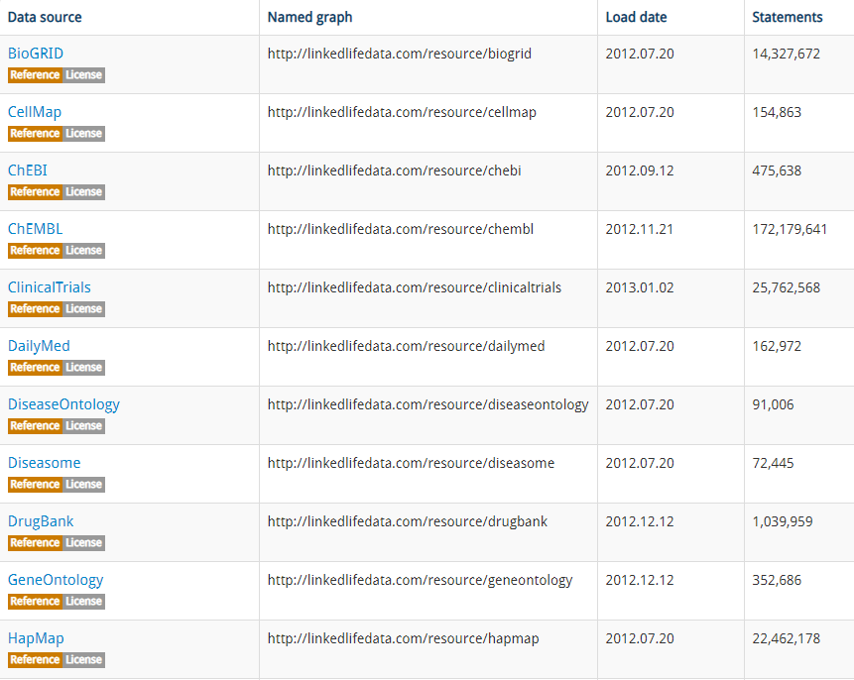
Life Sciences
The original and most advanced sem web application domain
Widely used by researchers and pharmaceutical companies
anatomy
illnesses, path interactions
chemicals, drugs
omics: genomics, proteomics, glycomics, metabolomics
translational science
clinical trials, healthcare
Specific areas:
drug research
dietary supplements
obesity
cancer research
electrophysiology
glycobiology
vaccines
Zika, COVID-19
etc, etc
Example: LinkedLifeData: 32 datasets, 1.5B entities, 10B triples, free
Diverse Uses of a Semantic Graph Database for Knowledge Organization and Research

Slide 13
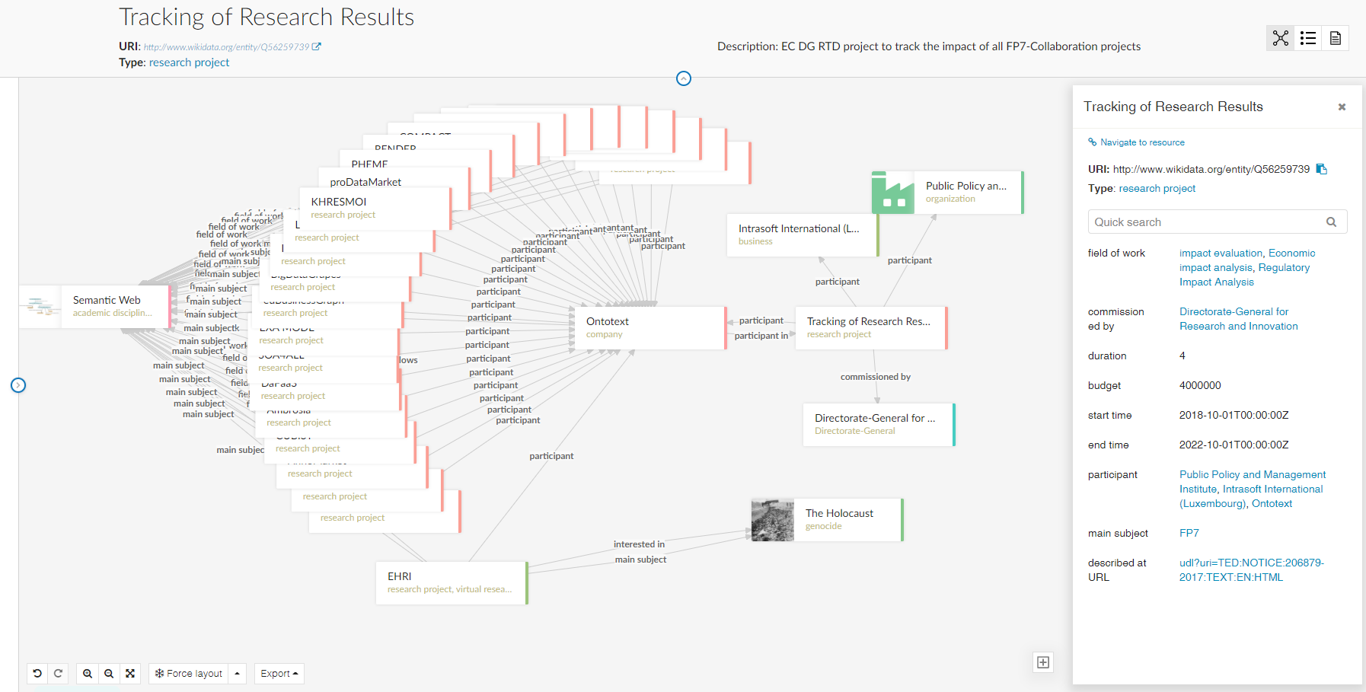
Science KGs: TRR Project
TRR info from Wikidata, visualized by Metaphactory
Diverse Uses of a Semantic Graph Database for Knowledge Organization and Research

Slide 14
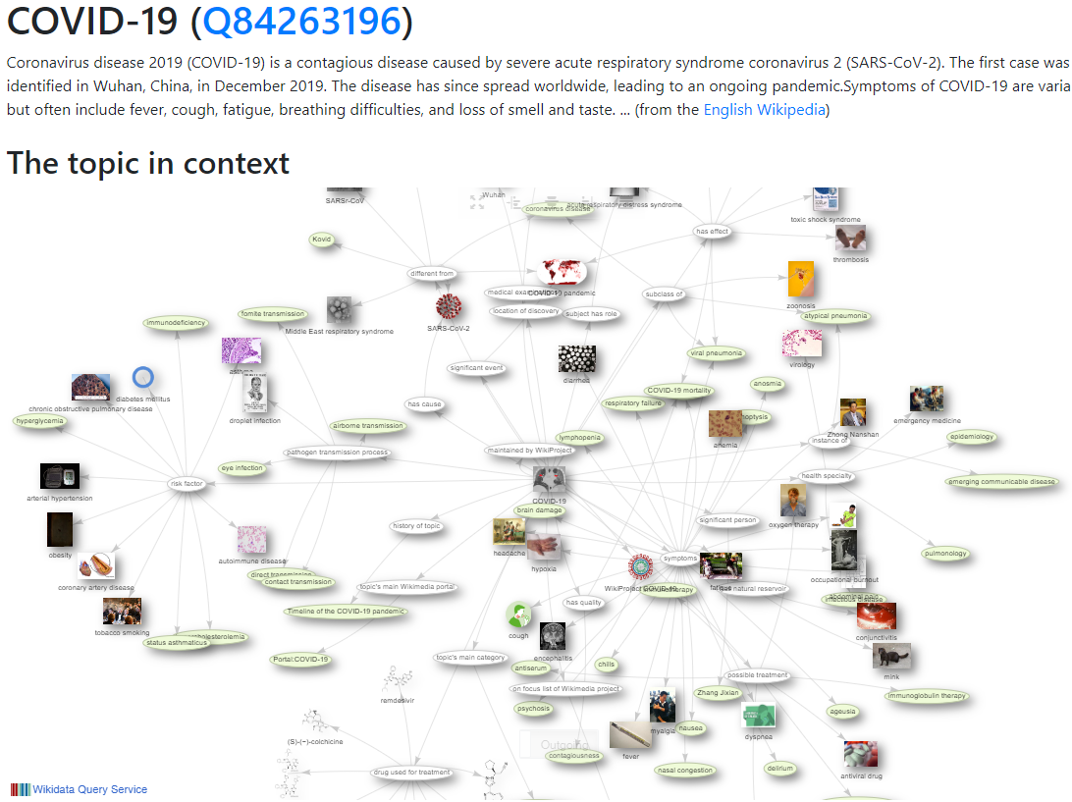
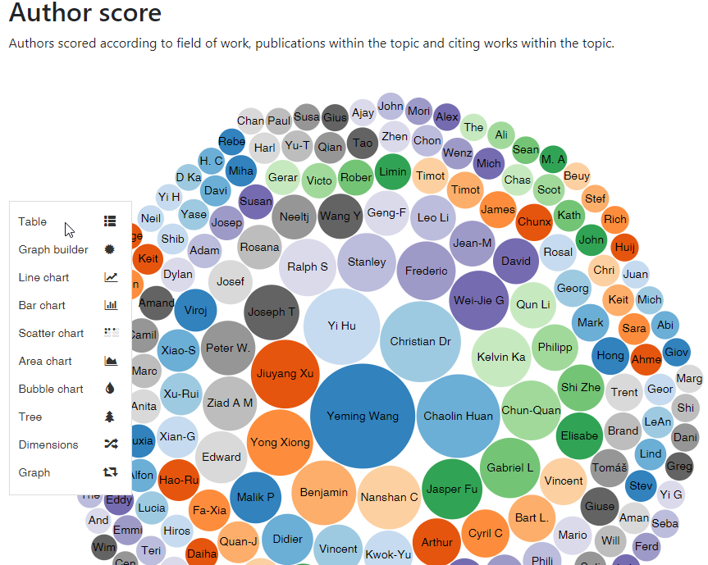
Science KGs: Wikidata Scholia, topic COVID-19
Diverse Uses of a Semantic Graph Database for Knowledge Organization and Research

Slide 15

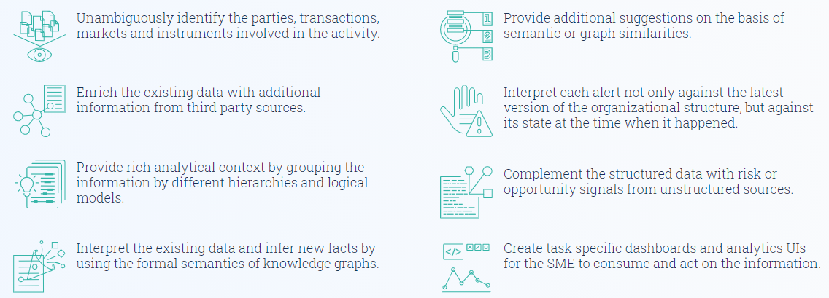
Financial Industry
Regulatory Compliance
Know Your Customer
Anti Money Laundering
Adverse Event Monitoring in the News
Master Data (Entity) Management
Asset Management
Trade Surveillance
Fight Stock Market Manipulation
Diverse Uses of a Semantic Graph Database for Knowledge Organization and Research

Slide 16
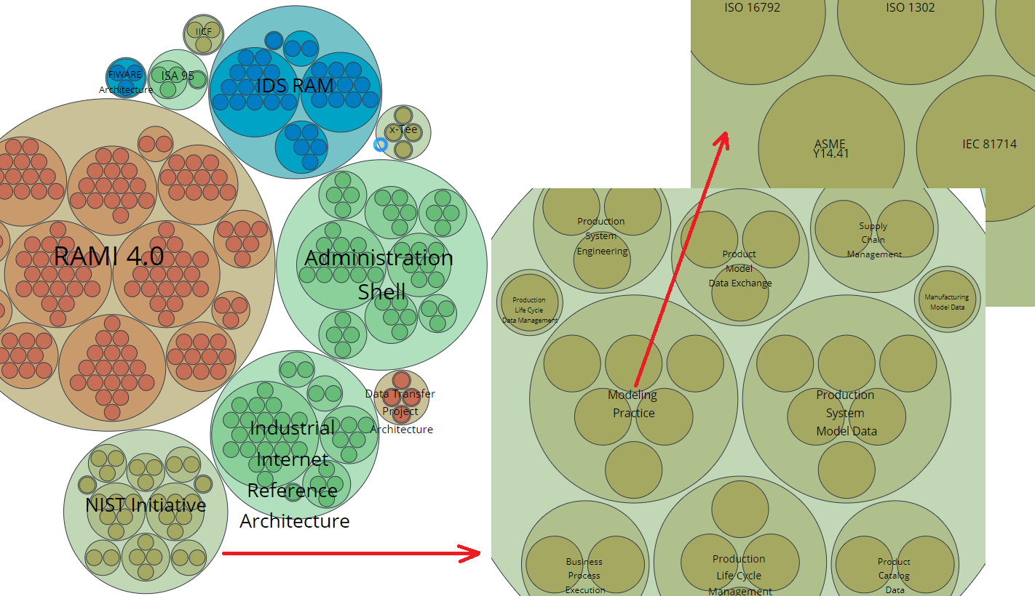
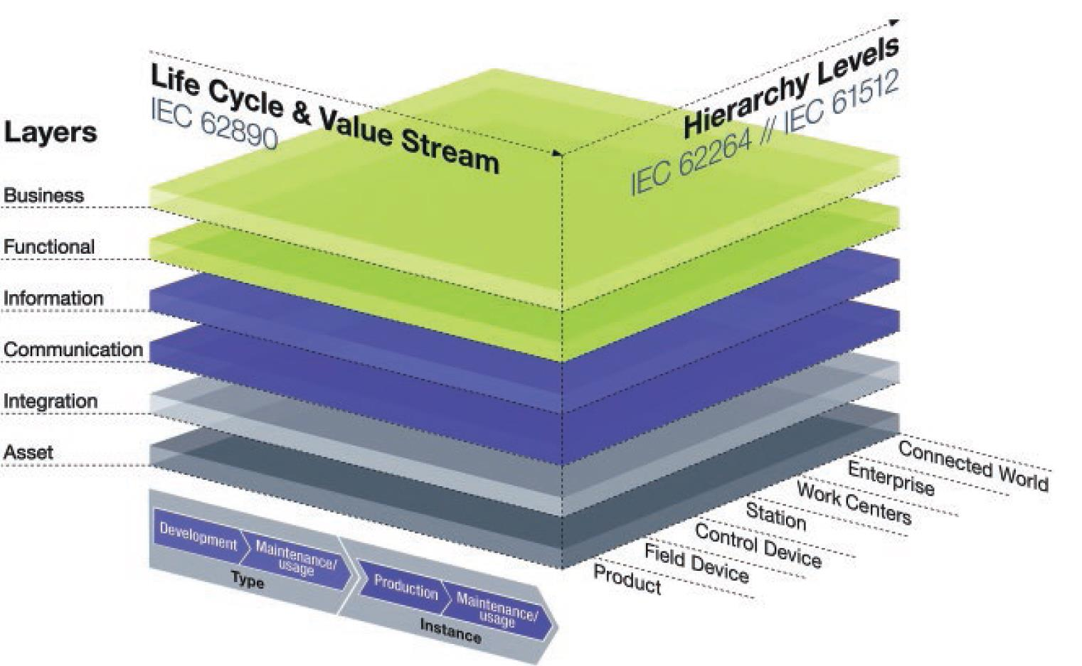
Industrial Data: Industry 4.0 Knowledge Graph
Industrie 4.0 Platform, AAS, RAMI (Germany, now ISO & IEC)
Industry 4.0 Knowledge Graph (Fraunhofer IAIS)
Ontotext Semantics 2020 presentation (slides, video)
Diverse Uses of a Semantic Graph Database for Knowledge Organization and Research

Slide 17
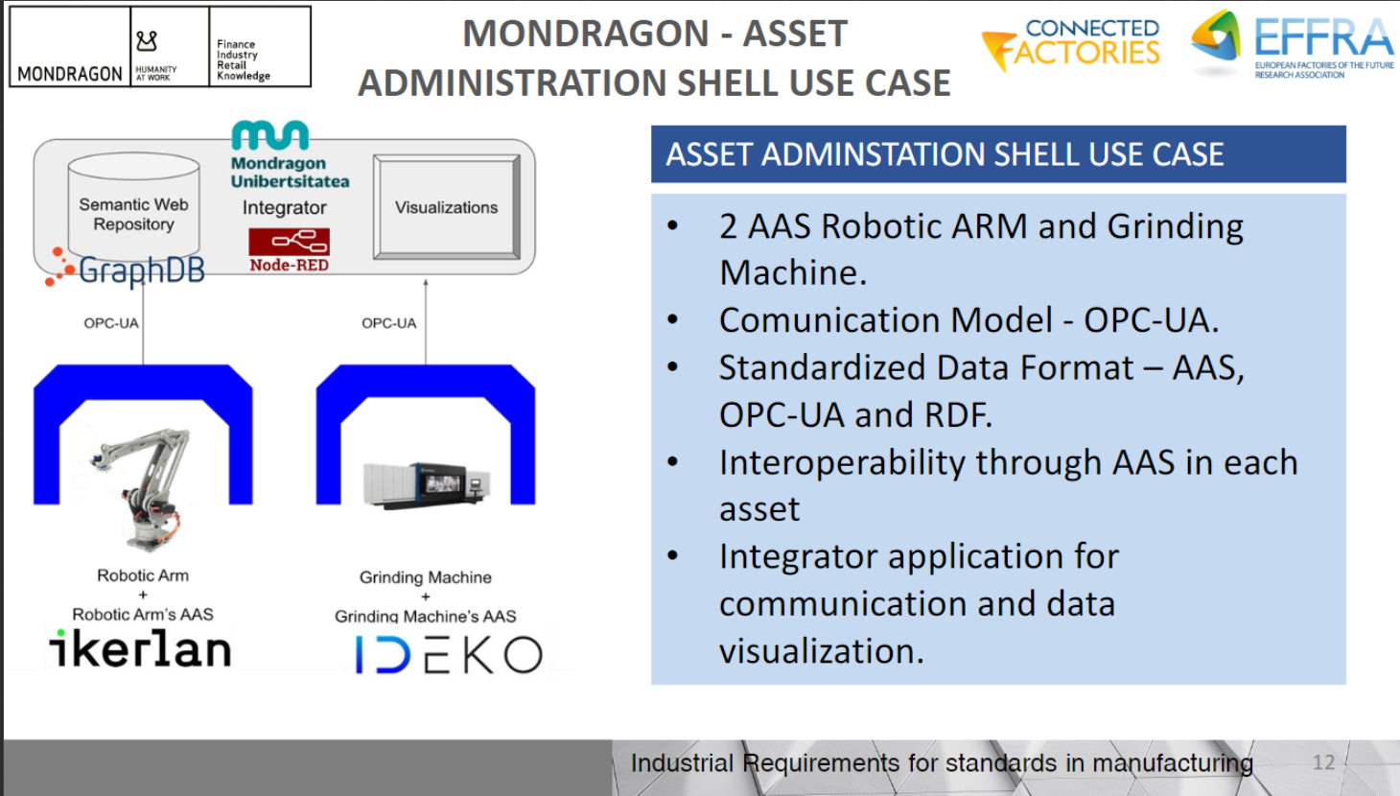
Industrial Data: Asset Admin Shell, IoT, Robotics
Mondragon
presentation at EFFRA webinar Standards for Digital Manufacturing, Oct 2020
268 companies
82k jobs
12 countries
14 R&D units
11.3B annual sales

Slide 18
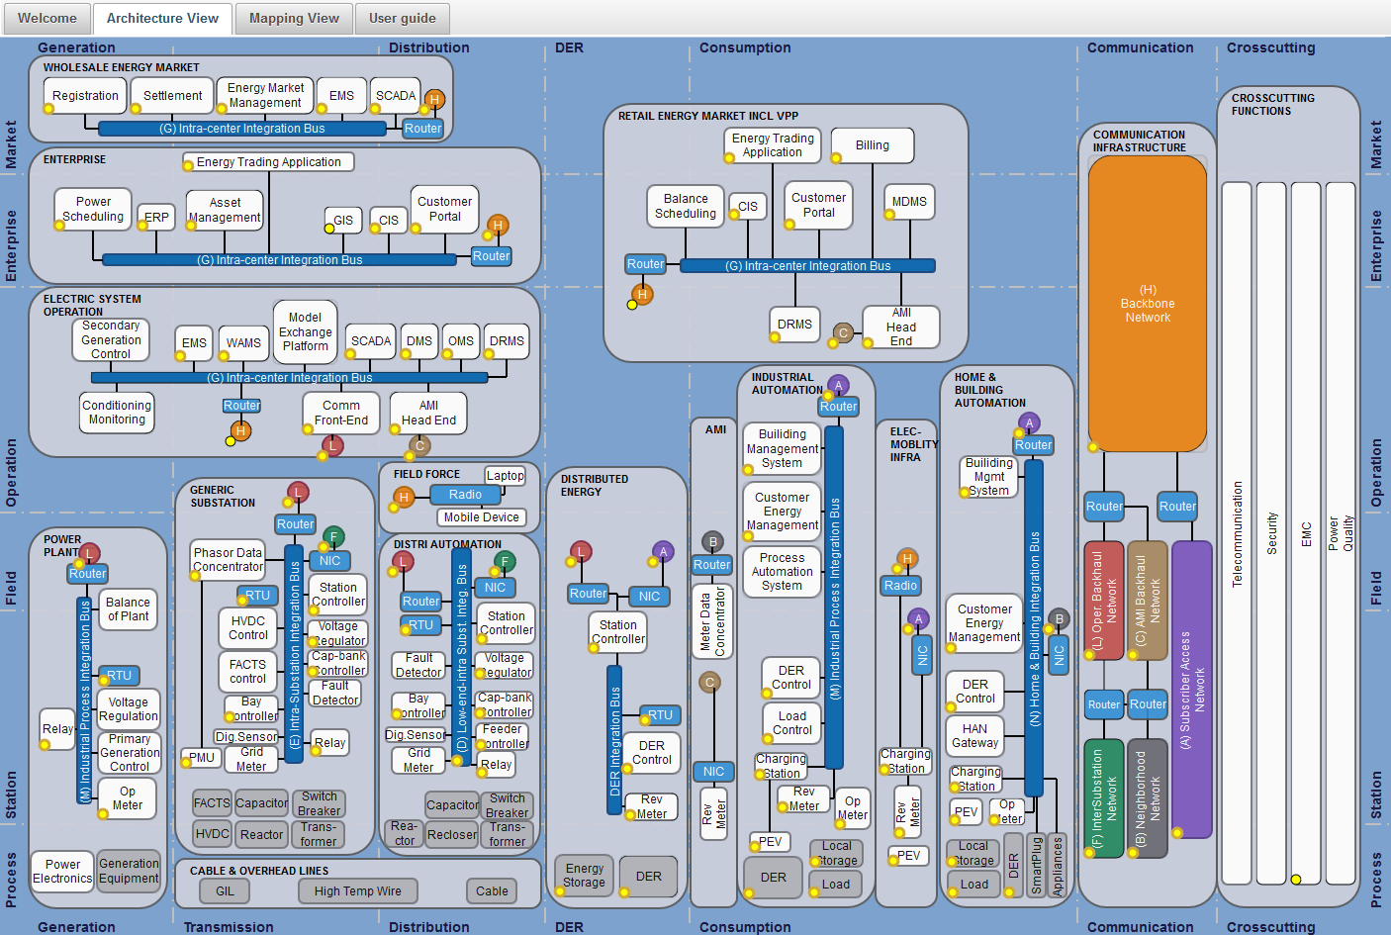
Electrical CIM
IEC Smart Grid Standards Map
6-7 IEC standards with common core: CIM
CIM is based on RDF
ENTSO-E: expanding and applying CIM in Europe (CGMES)
EU Regulations (Network Codes) for the Single Electricity Market
Energy Identification Code global IDs
Diverse Uses of a Semantic Graph Database for Knowledge Organization and Research

Slide 19
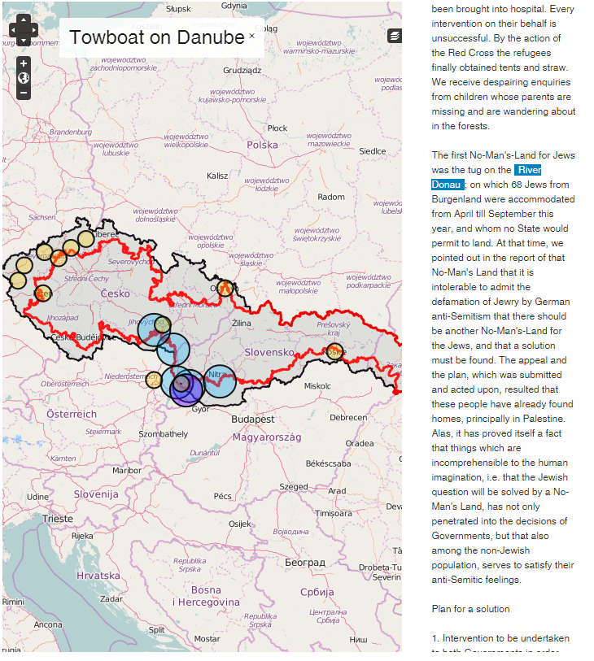
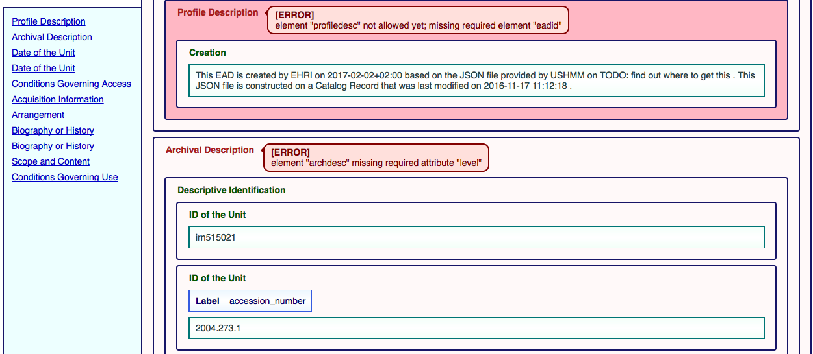
Digital Humanities
European Holocaust Research Infrastructure (JOCH 2017, eScience 2018, Umanistica Digitale 2019)
Semantic archive integration
Thesaurus management
Semantic enrichment
Diverse Uses of a Semantic Graph Database for Knowledge Organization and Research

Slide 20
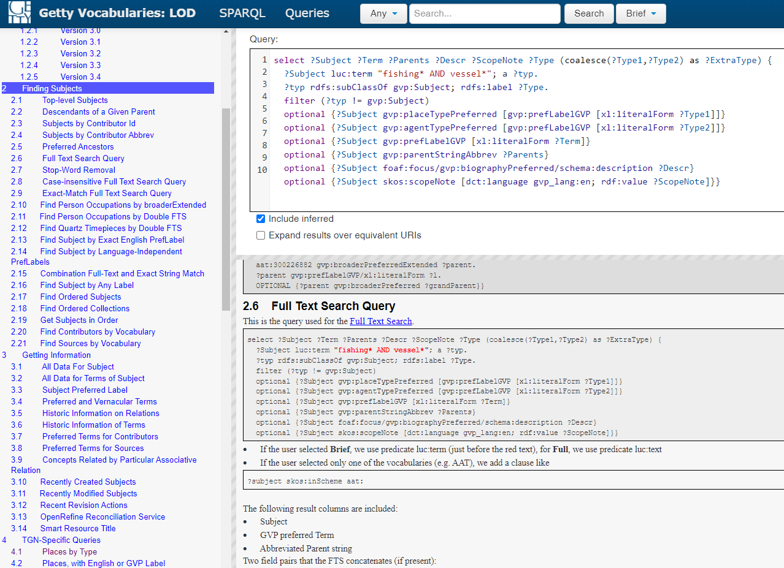
Cultural Heritage
Getty Vocabularies: AAT, TGN, ULAN
(SAA 2012, VRA 2014, CIDOC 2014)
Diverse Uses of a Semantic Graph Database for Knowledge Organization and Research

Slide 21
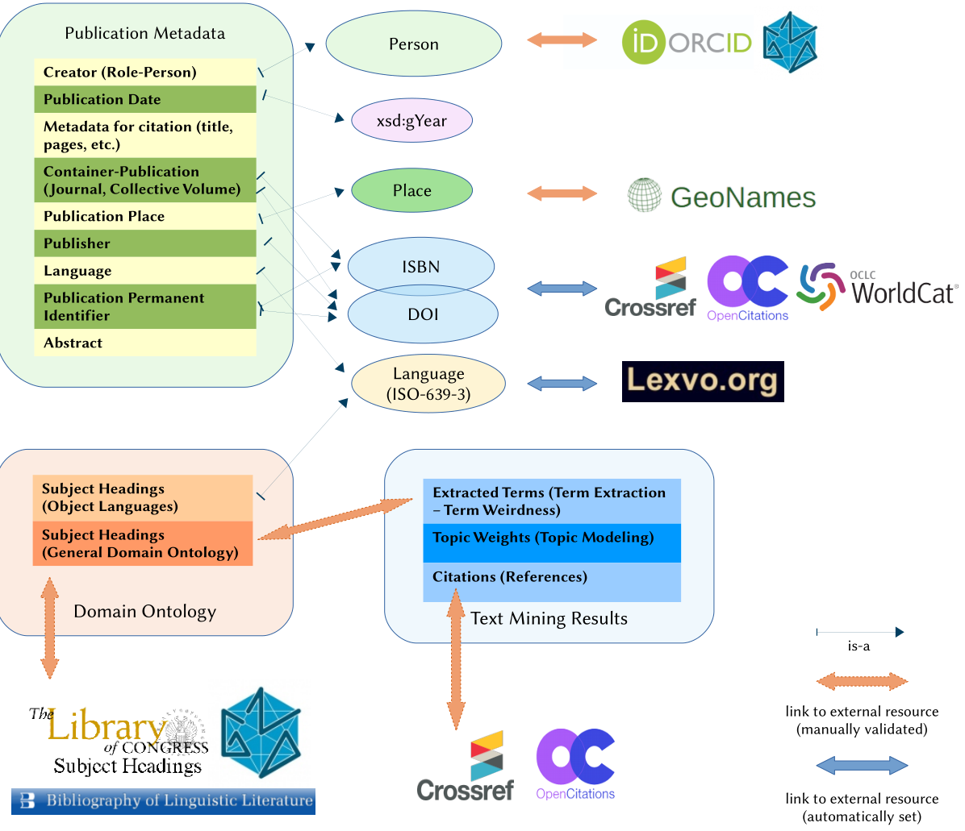
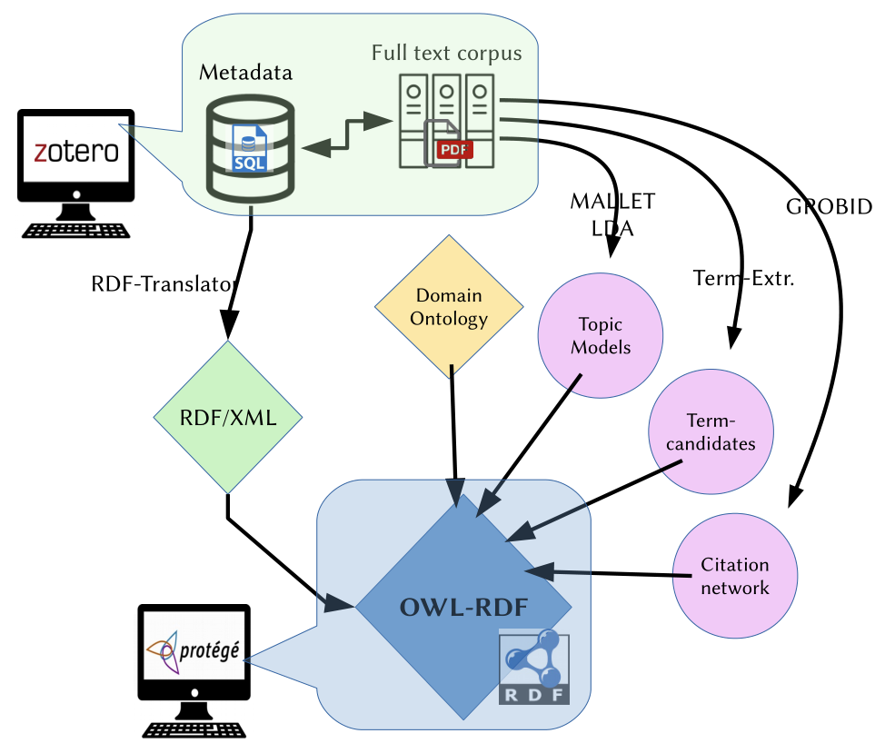
Lexicography (and KG of Science)
LexBib: Metalexicography as a KG (EuraLex 2018, LDK 2019), part of Elexis
Diverse Uses of a Semantic Graph Database for Knowledge Organization and Research

Slide 22
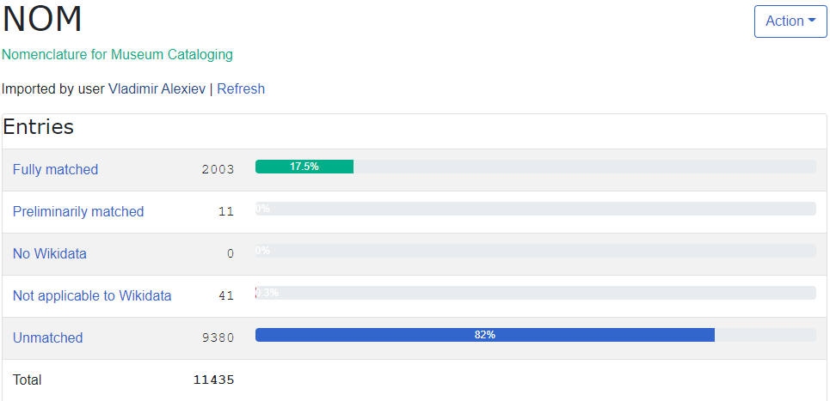
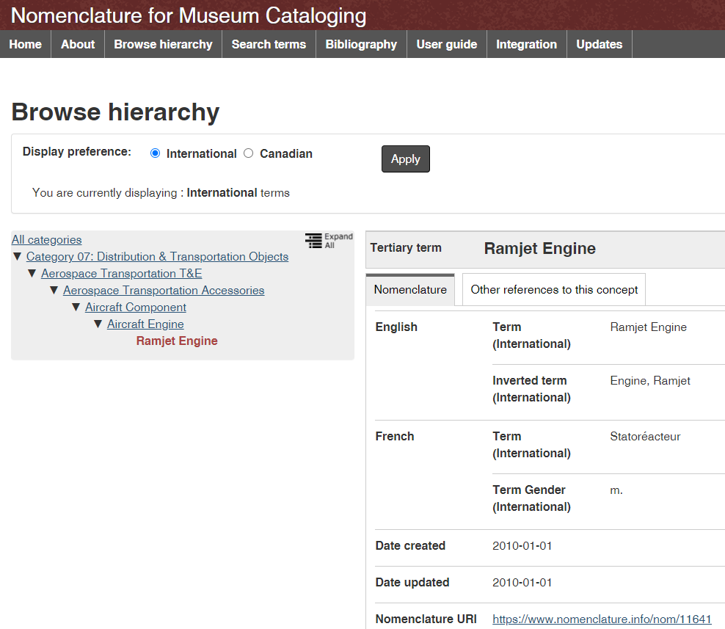
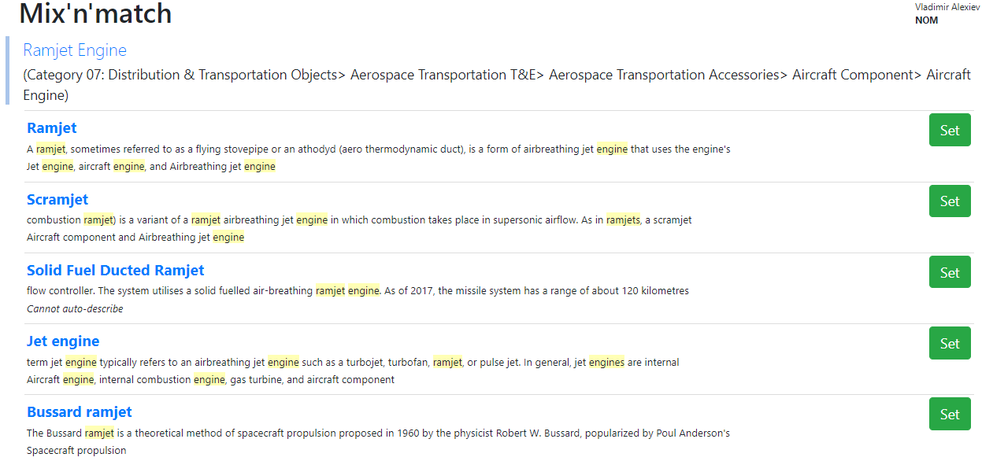
Cultural Heritage and Wikidata
Nomenclature for Museum Cataloging (CHIN, AASLH), Wikidata Mix-n-Match, Mobile matching mode
Diverse Uses of a Semantic Graph Database for Knowledge Organization and Research

Slide 23
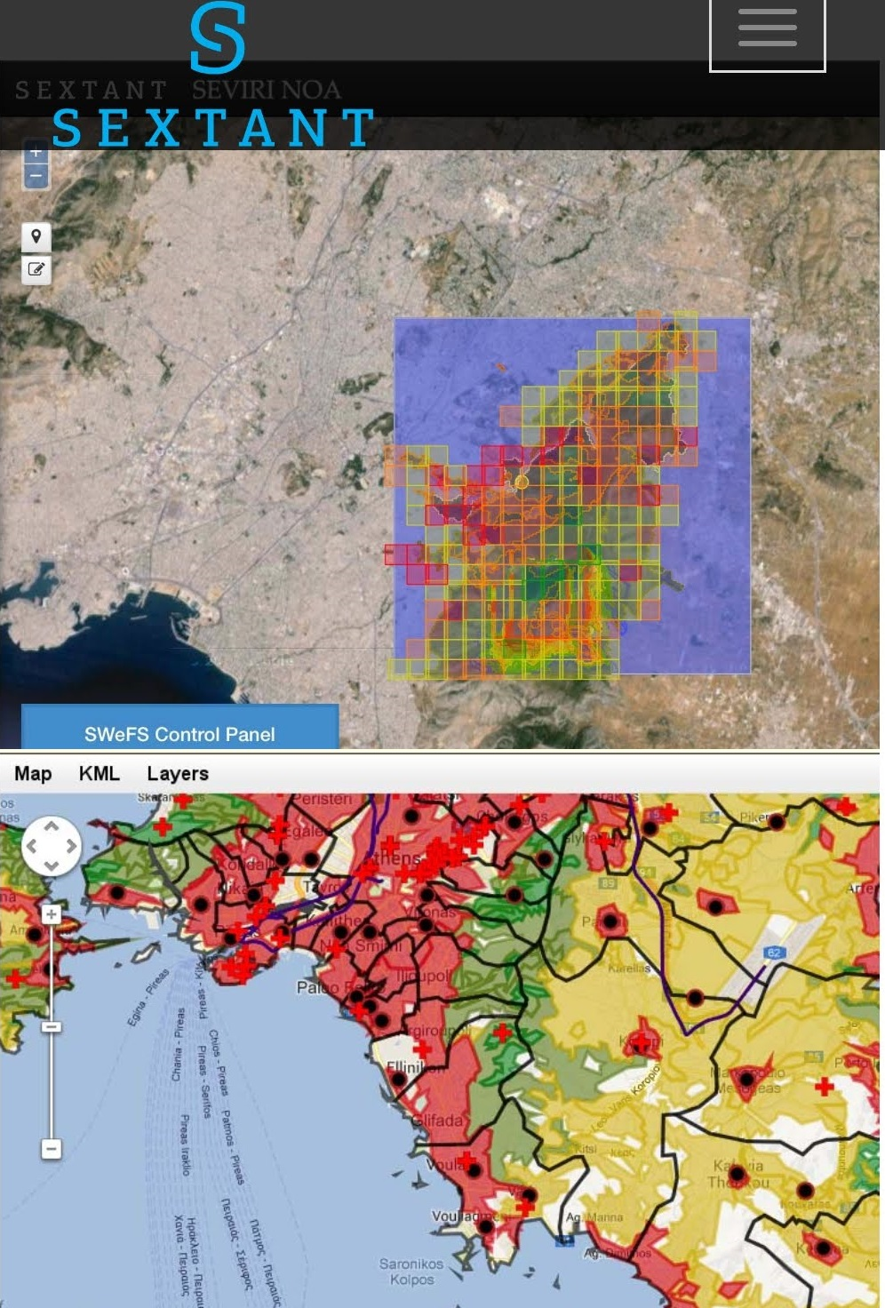
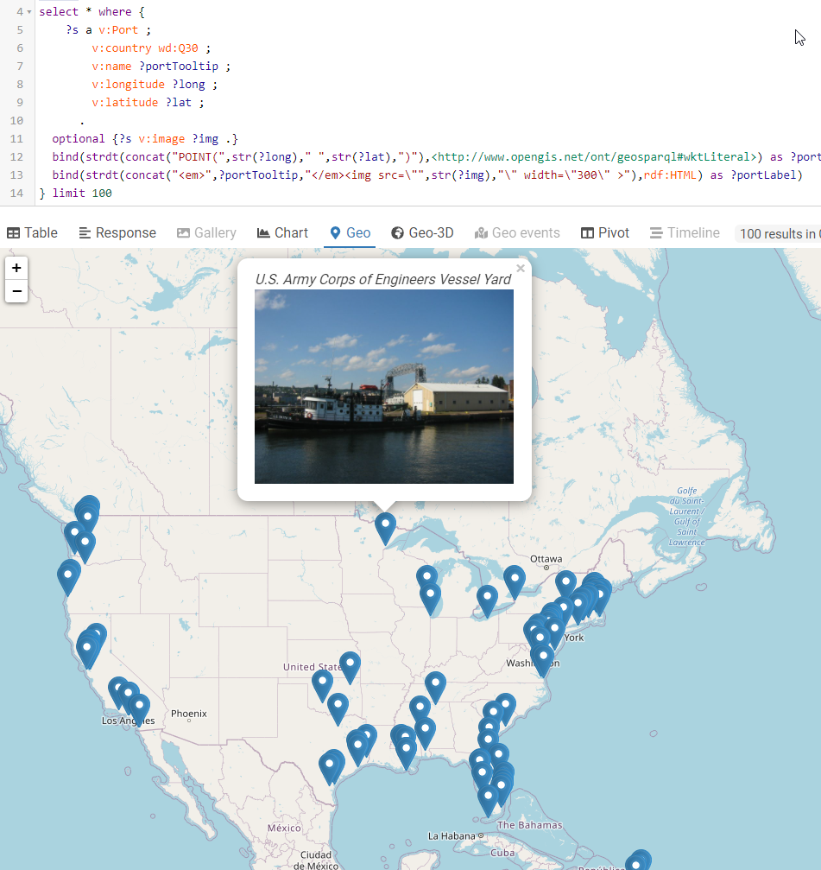
Geographic Data
GeoSPARQL for geo data representation and querying
GeoSPARQL 1.1 and 2.0 WG (github)
Benefits of Representing Spatial Data Using Semantic and Graph Technologies (OGC 2020)
Geo YasGUI for query & geo viz (ISPRS 2017)
Sextant for geo viz (JWS 2015)
Diverse Uses of a Semantic Graph Database for Knowledge Organization and Research

Slide 24
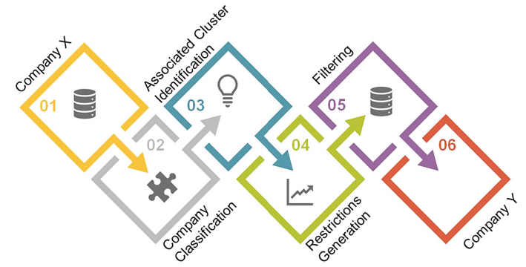
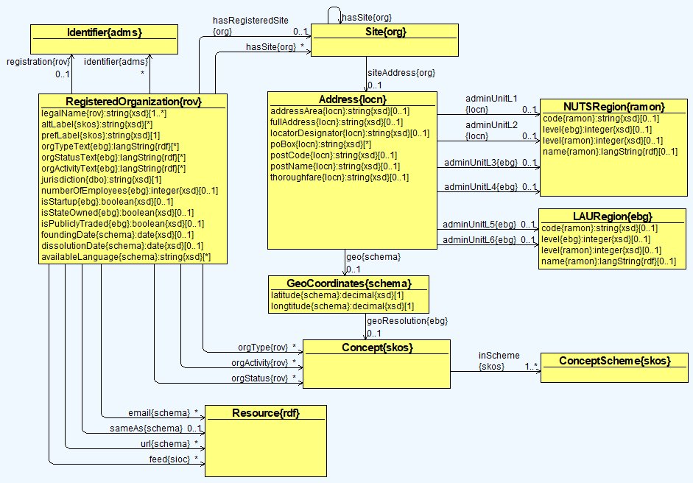
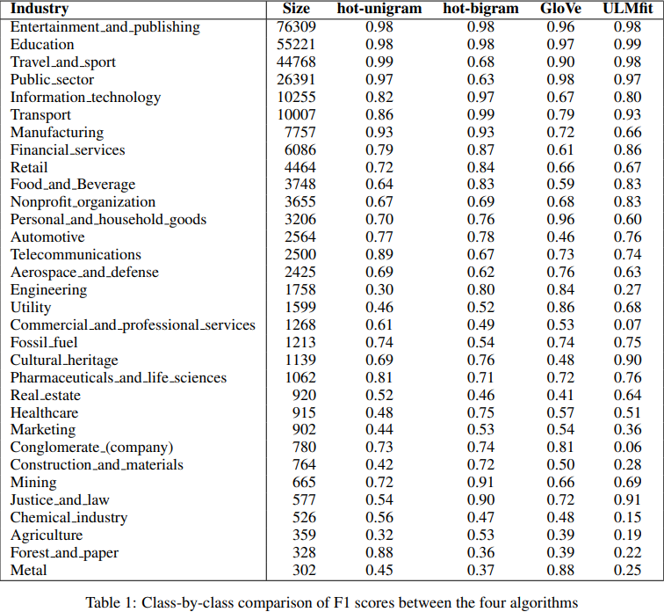
Company Data
euBusinessGraph: semantic integration of company data (SWJ 2020)
Investment recommendations (BIS 2019)
Industry classification using ML (BdKCSE 2019, RANLP 2019)
Diverse Uses of a Semantic Graph Database for Knowledge Organization and Research

Slide 25
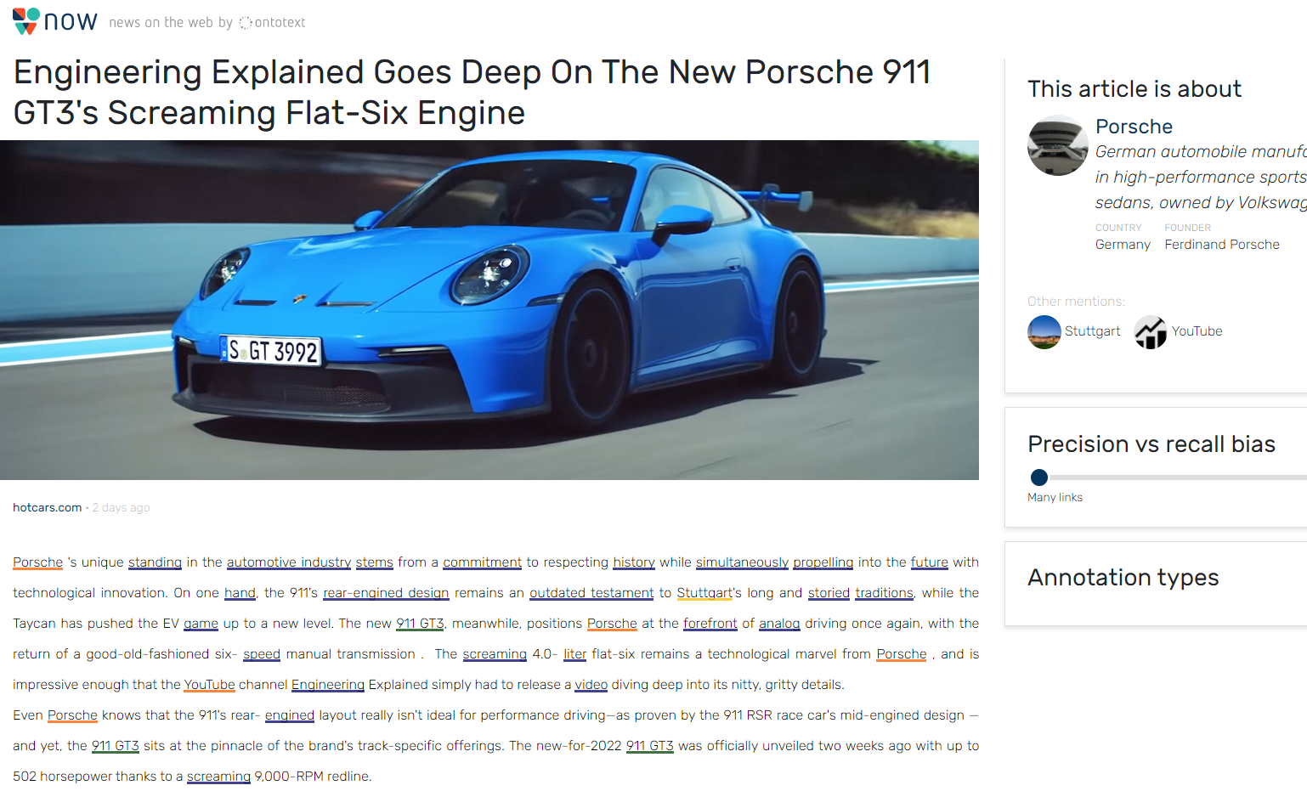
News, Entity Extraction, Semantic Search
News on the Web: semantic annotation
Diverse Uses of a Semantic Graph Database for Knowledge Organization and Research

Slide 26
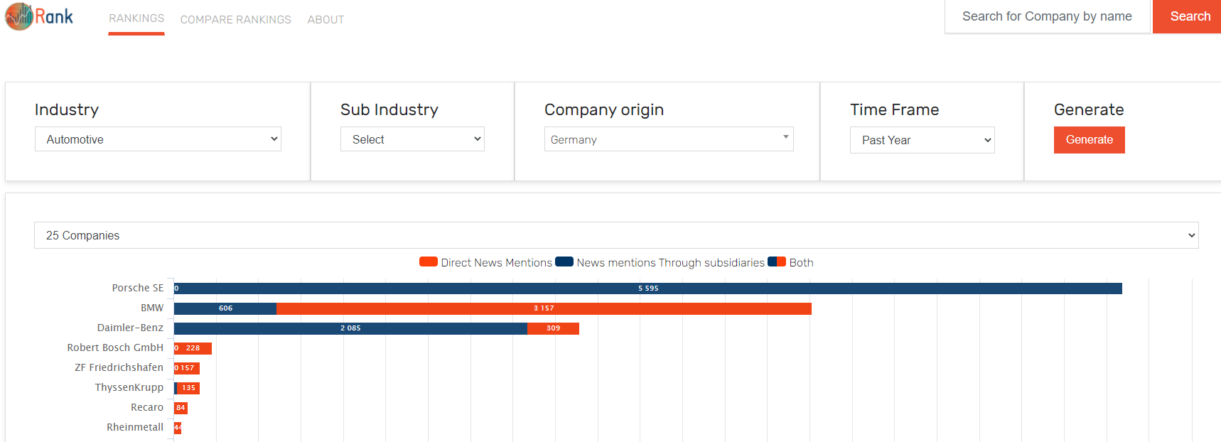
News, Ranking
Ontotext Rank: company popularity ranking
Diverse Uses of a Semantic Graph Database for Knowledge Organization and Research

Slide 27
Thank you for your attention!
Questions/comments: Vladimir.Alexiev@ontotext.com

